Slide 1



FPT Software
ANDROID TRAINING
LESSON 13
Version 0.1

Slide 2
Agenda
What Android gives you
MediaPlayer
MediaController
VideoView
SoundPool
References
2/11/2012
Android Insights - 3
<number>/18

Slide 3
Audio codec support
Subject
Section
Description
Codec support
General
Internal video, audio and image codec support
MediaPlayer
android.media
Control playback of video/audio files and streams
MediaController
android.widget
Standard controls for a MediaPlayer
VideoView
android.widget
Displays a video file.
SoundPool
android.media
Manages and plays audio resources for applications
AsyncPlayer
android.media
Plays a series of audio URIs, but does all the hard work on another thread
MediaRecorder
android.media
Record audio and video
FaceDetector
android.media
Identifies the faces of people in a bitmap object
AudioManager
android.media
Change various audio system properties (audio route, volume, ringer, etc.)
AudioTrack
android.media
Stream PCM buffers directly to the audio hardware for playback
Bold = covered today
Source: http://developer.android.com/guide/appendix/media-formats.html

Slide 4
MediaPlayer: Introduction
MediaPlayer lets you easily control playback of audio/video files and streams
Playback source can be:
  Raw resources bundled with the application
  Local files
  http/rtsp streams
MediaPlayer blocks the UI, so be sure to wrap your own thread around its functions, or use AsyncPlayer

Slide 5
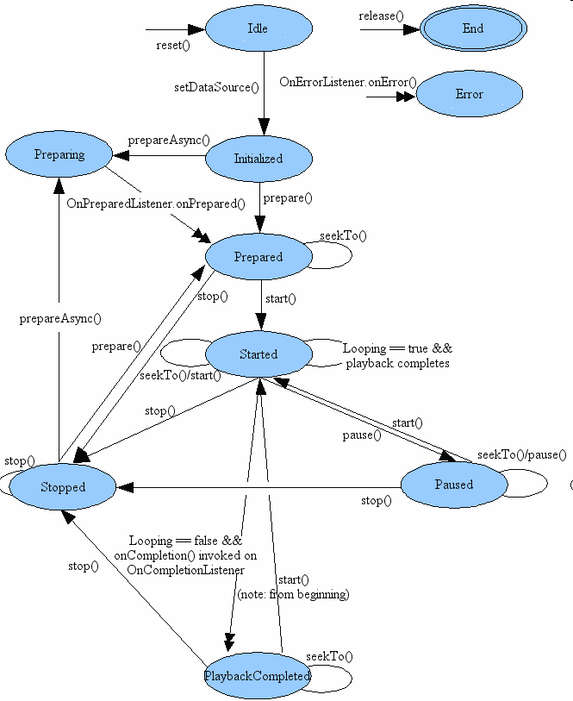
MediaPlayer: State diagram
Notes:
Single arrow = synchronous
Double arrow = asynchronous
Error and End states can be reached from any state in the diagram

Slide 6
MediaPlayer: Create and prepare
Option 1:
MediaPlayer mp = MediaPlayer.create(context, uri);
Option 2:
MediaPlayer mp;
mp = new MediaPlayer();
mp.setDataSource(uri);
mp.prepare();
Notes:
setDataSource(): sets the data source as URI or file descriptor
prepare(): Synchronously prepares data for playback by buffering data.
  Asynchronous version (prepareAsync) also available.
  Callback OnPreparedListener called if registered on completion

Slide 7
MediaPlayer: Seek to time
mp.seekTo(time);
Notes:
seekTo(): seeks to a specific time in the file in milliseconds.
  Call returns immediately, but seeking may take several seconds (especially for streams).
  Callback OnSeekCompleteListener called if registered on completion

Slide 8
MediaPlayer: Start playback
mp.start();
Notes:
start(): starts playback.

Slide 9
MediaPlayer: Additional control
mp.pause();
  Stops playback and keeps current seek position
mp.stop();
  Stops playback and loses current seek position
mp.seekTo();
  Move playhead to new time, buffer new content, and start playing. May take several seconds, especially if streaming.
mp.reset();
  Move player back to Idle state
mp.release();
  Move player to End state
  Release all internal resources held by player

Slide 10
MediaController: Introduction
MediaController gives you standard controls for a MediaPlayer
  Play, pause, rewind, fast forward, reverse, forward
  Seekable progress bar with overlaid playhead and buffer status
  Handles control updates and synchronization via callbacks
BUT it is peculiar: it is written primarily to be shown for a period of time then hidden
  Customization (either by extension or rewrite) may be necessary to achieve your desired behavior

Slide 11
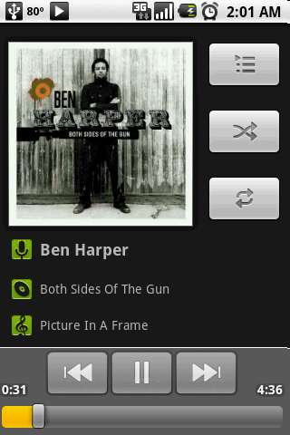
MediaController: Introduction
I’m a MediaController
Image source: http://www.simplehelp.net/2009/07/29/how-to-copy-music-to-your-android-phone-from-windows/

Slide 12
MediaController: Setting it up
Create and associate your MediaController to an ‘anchor’ view:
MediaController controller = new MediaController(this);
Button showControlsBtn = (Button)findViewById(R.id.showcontrols);
controller.setAnchorView(showControlsBtn);
When that ‘anchor’ view is activated, your MediaController will show for 3 seconds
To show your MediaController manually, call show:
controller.show();
MediaController will disappear automatically after 3 seconds by default

Slide 13
MediaController: Handling callbacks
Register a callback listener to control your MediaPlayer:
controller.setMediaPlayer(new MediaController.MediaPlayer() {
public int getBufferPercentage() {}
public int getCurrentPosition() {}
public int getDuration() {}
public boolean isPlaying() {}
public void pause() {}
public void seekTo(int pos) {}
public void start() {}
});
Connect the callbacks to your MediaPlayer, e.g.:
public void start() {
mp.start();
}

Slide 14
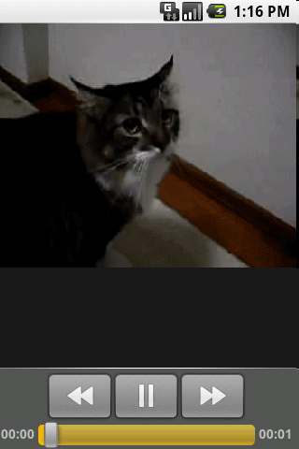
VideoView: Introduction
VideoView attaches to a MediaPlayer to provide default video rendering capabilities for video from various sources
  Computes its own measurement from the video
  Can be used in any layout manager
  Provides scaling, tinting, etc.
Image source: http://www.saturn.dti.ne.jp/~npaka/android/VideoViewEx/VideoViewEx.gif

Slide 15
VideoView: Setting it up
Create your VideoView (in XML in this case):
<VideoView android:id="@+id/video” android:layout_width="fill_parent” android:layout_height="fill_parent” />
Load your video file:
File clip=new File("/sdcard/test.mp4");
VideoView video=(VideoView)findViewById(R.id.video);
video.setVideoPath(clip.getAbsolutePath());
Associate your MediaController to VideoView and vice versa
MediaController controller = new MediaController(this);
controller.setMediaPlayer(video);
video.setMediaController(controller);
Show your video and its controls
video.requestFocus();

Slide 16
SoundPool: Introduction
SoundPool manages and plays audio resources for audio-heavy applications/games
SoundPool:
  Loads samples into memory from resources or files and decompresses them
  Manages the number of actively playing streams by assigned priority
  Allows playback rate and pitch changes real-time

Slide 17
SoundPool: Gaming Use Case
A typical use case: game has many levels of play, with unique sounds within each level
The game would:
  Create a new SoundPool object on level load
  Load each sound using the appropriate SoundPool.load() object in a thread
  Perform load early in the level load process to allow time for sound decompression to complete
  Play sounds with SoundPool.play(); pause, resume, adjust pitch, adjust speed, etc. all as required
  On level complete, clean up with SoundPool.release()

Slide 18
Playing JET content
The Android platform includes a JET engine that lets you add interactive playback of JET audio content in your applications. You can create JET content for interactive playback using the JetCreator authoring application that ships with the SDK. To play and manage JET content from your application, use the JetPlayer class.
For a description of JET concepts and instructions on how to use the JetCreator authoring tool. The tool is available fully-featured on the OS X and Windows platforms and the Linux version supports all the content creation features, but not the auditioning of the imported assets.

Slide 19
Playing JET content
Here's an example of how to set up JET playback from a .jet file stored on the SD card:
  JetPlayer myJet = JetPlayer.getJetPlayer();
  myJet.loadJetFile("/sdcard/level1.jet");
  byte segmentId = 0;
  // queue segment 5, repeat once, use General MIDI, transpose by -1 octave
  myJet.queueJetSegment(5, -1, 1, -1, 0, segmentId++);
  // queue segment 2
  myJet.queueJetSegment(2, -1, 0, 0, 0, segmentId++);
  myJet.play();
The SDK includes an example application — JetBoy — that shows how to use JetPlayer to create an interactive music soundtrack in your game. It also illustrates how to use JET events to synchronize music and game logic. The application is located at <sdk>/platforms/android-1.5/samples/JetBoy.

Slide 20
Audio Capture
Audio capture from the device is a bit more complicated than audio/video playback:
  Create a new instance of android.media.MediaRecorder using new
  Create a new instance of android.content.ContentValues and put in some standard properties like TITLE, TIMESTAMP, and the all important MIME_TYPE
  Create a file path for the data to go to (you can use android.content.ContentResolver to create an entry in the Content database and get it to assign a path automatically which you can then use)
  Set the audio source using MediaRecorder.setAudioSource(). You will probably want to use MediaRecorder.AudioSource.MIC
  Set output file format using MediaRecorder.setOutputFormat()
  Set the audio encoder using MediaRecorder.setAudioEncoder()
  Call prepare() on the MediaRecorder instance.
  To start audio capture, call start().
  To stop audio capture, call stop().
  When you are done with the MediaRecorder instance, call release() on it.

Slide 21
Audio Capture
Example: Audio Capture Setup and Start
  recorder = new MediaRecorder();
  ContentValues values = new ContentValues(3);
  values.put(MediaStore.MediaColumns.TITLE, SOME_NAME_HERE);
  values.put(MediaStore.MediaColumns.TIMESTAMP, System.currentTimeMillis());
  values.put(MediaStore.MediaColumns.MIME_TYPE, recorder.getMimeContentType());
  ContentResolver contentResolver = new ContentResolver();
  Uri base = MediaStore.Audio.INTERNAL_CONTENT_URI;
  Uri newUri = contentResolver.insert(base, values);
  if (newUri == null) {
    // need to handle exception here - we were not able to create a new
    // content entry
  }
  String path = contentResolver.getDataFilePath(newUri);
  // could use setPreviewDisplay() to display a preview to suitable View here
  recorder.setAudioSource(MediaRecorder.AudioSource.MIC);
  recorder.setOutputFormat(MediaRecorder.OutputFormat.THREE_GPP);
  recorder.setAudioEncoder(MediaRecorder.AudioEncoder.AMR_NB);
  recorder.setOutputFile(path);
  recorder.prepare();
  recorder.start();

Slide 22
Stop Recording
  recorder.stop();
  recorder.release();

Slide 23
Using the Camera
To access the camera hardware, you need to add the CAMERA permission to your application manifest
  <uses-permission android:name=”android.permission.CAMERA”/>
To access the Camera Service, use the static open method on the Camera class. When your application has finished with the camera, remember to relinquish your hold on the Service by calling release
  Camera camera = Camera.open();
  [ … Do things with the camera … ]
  camera.release();

Slide 24
Using the Camera
Controlling Camera Settings
  The current camera settings are available as a Camera.Parameters object. Call the getParameters method on the Camera to access the current parameters.
  You can use the set* methods on the returned Parameters to modify the settings.
    Camera.Parameters parameters = camera.getParameters();
    parameters.setPictureFormat(PixelFormat.JPEG);
    camera.setParameters(parameters);
  The Camera Parameters can be used to specify the image and preview size, image format, and preview frame rate.

Slide 25
Using the Camera
Using the Camera Preview
  The camera preview can be displayed in real time onto a Surface
    camera.setPreviewDisplay(mySurface);
    camera.startPreview();
    [ … ]
    camera.stopPreview();
  You can also assign a PreviewCallback to be fired for each preview frame, allowing you to manipulate or display each preview frame individually.
    camera.setPreviewCallback(new PreviewCallback() {
    public void onPreviewFrame(byte[] _data, Camera _camera) {
    // TODO Do something with the preview image.
    }
    });

Slide 26
Using the Camera
Taking a Picture
  Take a picture by calling takePicture on a Camera object, passing in a ShutterCallback and PictureCallback implementations for the RAW and JPEG-encoded images. Each picture callback will receive a byte array representing the image in the appropriate format, while the shutter callback is triggered immediately after the shutter is closed.

Slide 27
Using the Camera
private void takePicture() {
camera.takePicture(shutterCallback, rawCallback, jpegCallback);
}
ShutterCallback shutterCallback = new ShutterCallback() {
public void onShutter() {
// TODO Do something when the shutter closes.
}
};
PictureCallback rawCallback = new PictureCallback() {
public void onPictureTaken(byte[] _data, Camera _camera) {
// TODO Do something with the image RAW data.
}
};
PictureCallback jpegCallback = new PictureCallback() {
public void onPictureTaken(byte[] _data, Camera _camera) {
// TODO Do something with the image JPEG data.
}
};

Slide 28
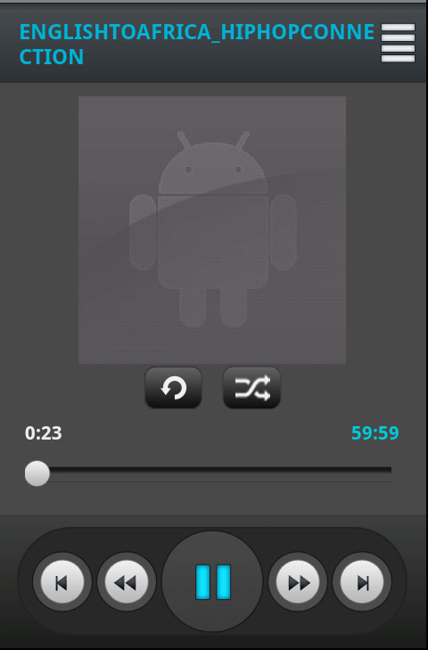
Homework
Create Mediaplayer

Slide 29
Thank you!

